Slide 1
A Crop Pest Classification Model Using Deep Learning Techniques
By
YUSRA YASAR M (MES21MCA-2060)
Product Owner
Nowshad CV
Assistant Professor
Master of Computer Applications
MES College Of Engineering ,Kuttippuram

Slide 2

Table of Content
Introduction
Existing System
Proposed System
Modules
System Requirement
DFD
Product Backlog
User Story
Project Plan
Sprint
Department of Computer Applications
2

Slide 3
INTRODUCTION
Crop pest classification is a critical component of modern agriculture, as it helps in identifying and managing the various pests that threaten crop production.
Traditional methods of pest classification, such as morphological and behavioral observations, have limitations in terms of accuracy and efficiency.
With the advancement of deep learning algorithms, there is now an opportunity to provide a more accurate and efficient approach to crop pest classification.
Department of Computer Applications
3

Slide 4
INTRODUCTION (cont)
Deep learning is a subset of machine learning that uses artificial neural networks to perform tasks that were once thought to require human intelligence, such as image recognition. In the context of crop pest classification
Deep learning algorithms are trained using large datasets of pest images and features, allowing them to accurately recognize and classify different pests.
This technology has the potential to overcome the limitations of traditional methods and provide more robust and reliable pest classification results.
Department of Computer Applications
4

Slide 5
EXISTING SYSTEM
The introduction of deep learning for crop pest classification is an exciting development in the field of agriculture and has the potential to revolutionize the way we approach pest management.
In this paper, we will explore the potential of deep learning for crop pest classification and its importance in ensuring the long-term sustainability of food production and the protection of the environment from harmful pesticide use.
Department of Computer Applications
5

Slide 6
PROPOSED SYSTEM
It is highly relevant in modern agriculture, as it provides a powerful tool for farmers and agricultural experts. Crop pest classification is relevant for a number of reasons, and they are:
Minimization of pesticide use: Pesticides are commonly used to control pests, but their use can also have harmful effects on the environment and human health. Accurate pest classification can help to minimize the use of pesticides by providing more targeted and effective pest management strategies
Economic benefits: Pests can cause significant financial losses to farmers and the agricultural industry as a whole. Accurate pest classification and effective pest management strategies can help to reduce these losses and contribute to the economic stability of the agricultural industry.
Department of Computer Applications
6

Slide 7
MODULES
Agriculture Officer:
Login
Dataset management
Manage Crop
Manage expert
View registered users
View feedback and send Reply
Add& manage notification
verify farmer
2. Expert
login
Add& manage tips
Manage Fertilizer
view notification
view doubt & send reply
Department of Computer Applications
7

Slide 8
3. Farmer :
Register
Login
view notification
Pest prediction
send complaint& view reply
view tips
send doubt and view reply
Department of Computer Applications
8

Slide 9
SYSTEM REQUIREMENT
SOFTWARE ENVIRONMENT:
Front End : HTML, CSS, Java script, XML
Back End : Python (Flask)
Data Base : Mysql
Software used : Pycharm
Department of Computer Applications
9

Slide 10
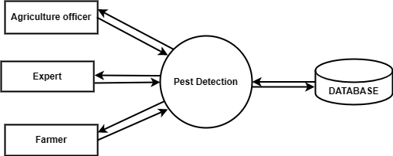
Level:0
Department of Computer Applications
10

Slide 11
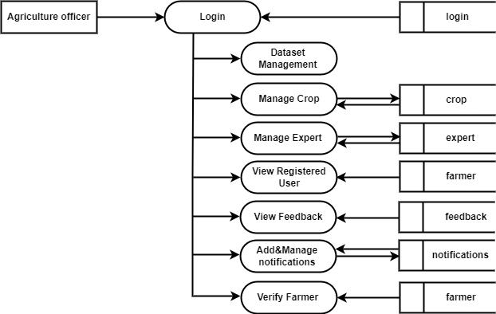
Level:1
Department of Computer Applications
11

Slide 12
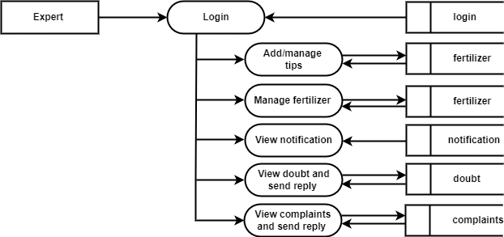
Level:1
Department of Computer Applications
12

Slide 13
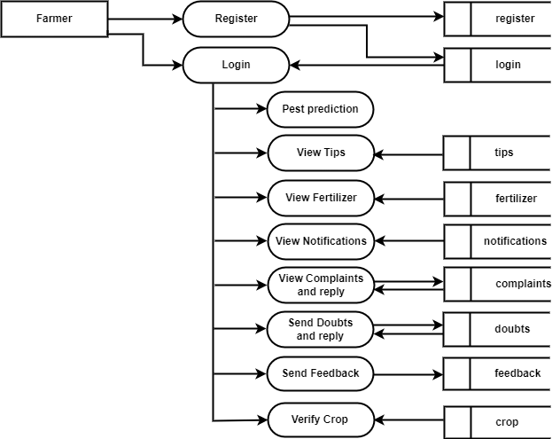
Level:1
Department of Computer Application
13

Slide 14
PRODUCT BACKLOG
Id | Name | Priority | Status
1 | Registration | High | Completed
2 | Login | High | Completed
3 | Process | High | Planned
4 | Report | Medium | Planned
Department of Computer Applications
14

Slide 15
USER STORY
User Story Id | As a <Type of User> | I want to < perform some task> | So that I can <Achieve my goal>
1 | Agriculture officer | Login | Access the System
2 | Agriculture officer | Verify farmer | Verify farmer
3 | Farmer | Registering | registering
4 | Agriculture officer | Manage Dataset | Manage Dataset For pest prediction
5 | Farmer | Login | Access the System
6 | Farmer | Pest prediction | Pest prediction by dataset
7 | Agriculture officer | Manage Crop | Add/ Delete Crop
8 | Farmer | View Crop | View Crop
9 | Agriculture officer | Manage Expert | Manage Expert
10 | Expert | Login | Access the System
11 | Agriculture officer | View farmer | View Registered farmer
12 | Agriculture officer | View Feedback | View Feedback
Department of Computer Applications
15

Slide 16
User Story Id | As a <Type of User> | I want to < perform some task> | So that I can <Achieve my goal>
13 | Farmer | Send feedback | Post feedback
14 | Agriculture officer | Manage Notification | Add/delete Notification
15 | Expert | View Notification | View Notification
16 | Farmer | View Notification | View Notification
17 | Expert | Manage Tips | Add or delete Tips
18 | Farmer | View Tips | View Tips
19 | Expert | Manage fertilizer | Add or delete fertilizer
20 | Farmer | View fertilizer | View fertilizer
21 | Expert | View doubts and reply | View doubts and reply
22 | Farmer | Send doubts and reply | Send doubts and reply
23 | Expert | View Complaints and reply | View Complaints and reply
24 | Farmer | Send Complaints and reply | Send Complaints and reply
Department of Computer Applications
16

Slide 17
PROJECT PLAN
User Story ID | Sprint | Start Date | End Date | Hours | Status
1,2,3,4,5,6, | Sprint 1 | 07/02/2023 | 28/02/2023 | 21 | Completed
7,8,9,10,11,12, | Sprint 2 | 01/03/2023 | 15/03/2023 | 15 | Planned
13,14,15,16,17,18 | Sprint 3 | 16/03/2023 | 31/04/2023 | 30 | Planned
19,20,21,22,23,24 | Sprint 4 | 17/04/2023 | 15/05/2023 | 17 | Planned
Department of Computer Applications
17

Slide 18
SPRINT-1
Backlog item | Status and completion date | ORIGINAL ESTIMATE | DAY 1 07/02/23 | DAY 2 08/02/23 | DAY 3 09/02/23 | DAY 4 10/02/23 | DAY 5 13/02/23 | DAY 6 14/02/23 | DAY 7 15/02/23 | DAY 8 16/02/23 | DAY 9 17/02/23 | DAY 10 20/02/23 | DAY 11 21/02/23 | DAY 12 22/02/23 | DAY 13 23/02/23 | DAY 14 24/02/23 | DAY 15 27/02/23 | DAY 16 28/02/23
USER STORY #1 |  | HRS | HRS | HRS | HRS | HRS | HRS | HRS | HRS | HRS | HRS | HRS | HRS | HRS | HRS | HRS | HRS | HRS
UI designing | 10/02/23 | 2 | 1 | 0 | 1 | 0 | 0 | 0 | 0 | 0 | 0 | 0 | 0 | 0 | 0 | 0 | 0 | 0
coding | 17/02/23 | 6 | 0 | 0 | 0 | 0 | 1 | 2 | 1 | 2 | 0 | 0 | 0 | 0 | 0 | 0 | 0 | 0
Testing | 28/02/23 | 2 | 0 | 0 | 0 | 0 | 0 | 0 | 0 | 0 | 0 | 0 | 0 | 1 | 0 | 1 | 0 | 0
Total |  | 10 | 1 | 0 | 1 | 0 | 1 | 2 | 1 | 2 | 0 | 0 | 0 | 1 | 0 | 1 | 0 | 0
Department of Computer Applications
18

Slide 19
SPRINT-2
Backlog item | Status and completion date | ORIGINAL ESTIMATE | DAY 1 01/03/23 | DAY 2 02/03/23 | DAY 3 03/03/23 | DAY 4 04/03/23 | DAY 5 05/03/23 | DAY 6 06/03/23 | DAY 7 07/03/23 | DAY 8 08/03/23 | DAY 9 09/03/23 | DAY 10 10/03/23 | DAY 11 11/03/23 | DAY 12 12/03/23 | DAY 13 13/03/23 | DAY 14 14/03/23 | DAY 15 15/03/23 | DAY 16 16/03/23
USER STORY #1 |  | HRS | HRS | HRS | HRS | HRS | HRS | HRS | HRS | HRS | HRS | HRS | HRS | HRS | HRS | HRS | HRS | HRS
UI designing | 01/03/23 | 2 | 1 | 0 | 1 | 0 | 0 | 0 | 0 | 0 | 0 | 0 | 0 | 0 | 0 | 0 | 0 | 0
coding | 10/03/23 | 6 | 0 | 0 | 0 | 0 | 1 | 2 | 1 | 2 | 0 | 0 | 0 | 0 | 0 | 0 | 0 | 0
Testing | 15/03/23 | 2 | 0 | 0 | 0 | 0 | 0 | 0 | 0 | 0 | 0 | 0 | 0 | 1 | 0 | 1 | 0 | 0
Total |  | 10 | 1 | 0 | 1 | 0 | 1 | 2 | 1 | 2 | 0 | 0 | 0 | 1 | 0 | 1 | 0 | 0
Department of Computer Applications
18

Slide 20
THANK YOU...

